Slide 1
Reproduction of

Slide 2
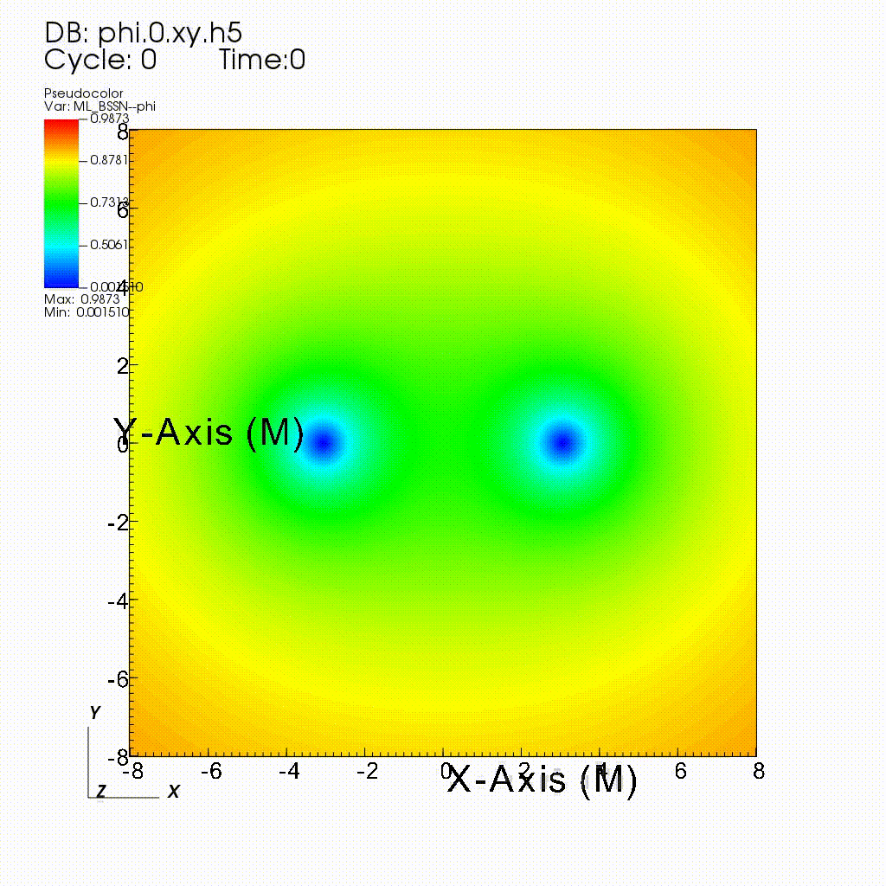

Result
Spin aligned (with the orbital angular momentum)
Spin anti-aligned

Slide 3
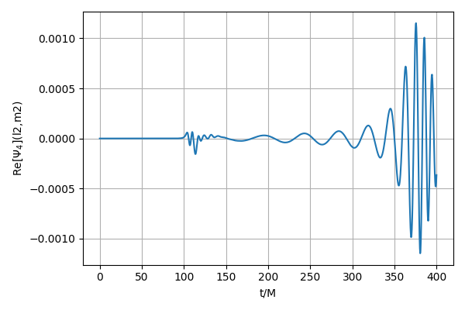
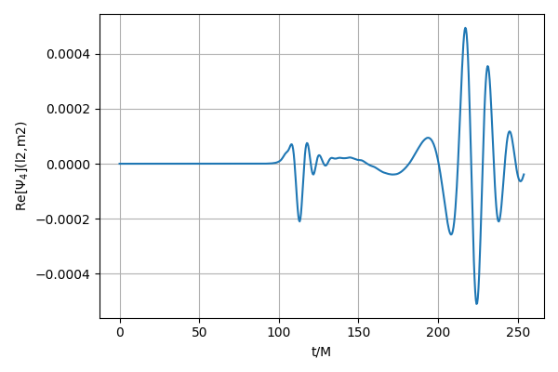
Result
Real part of WeylScalar4 at r=100M

Slide 4
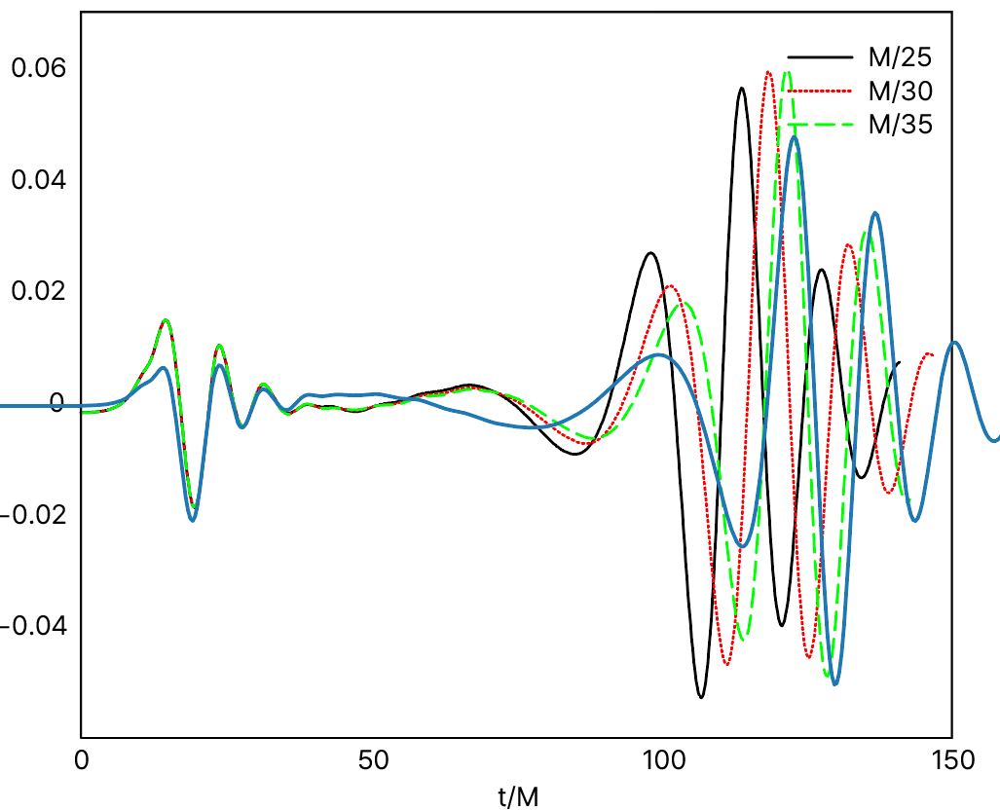
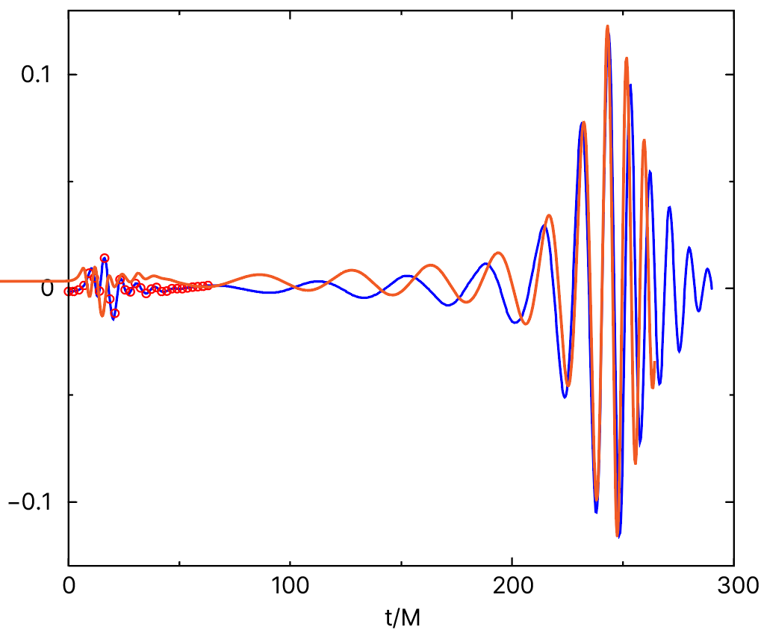
Original paper : at r=10M

Slide 5
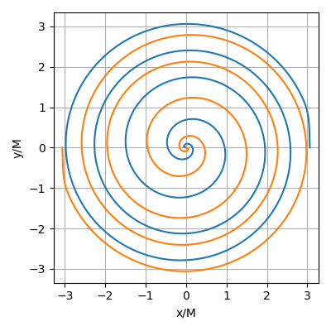
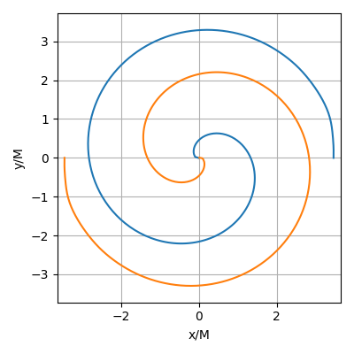
Result

Slide 6
Result

Slide 7
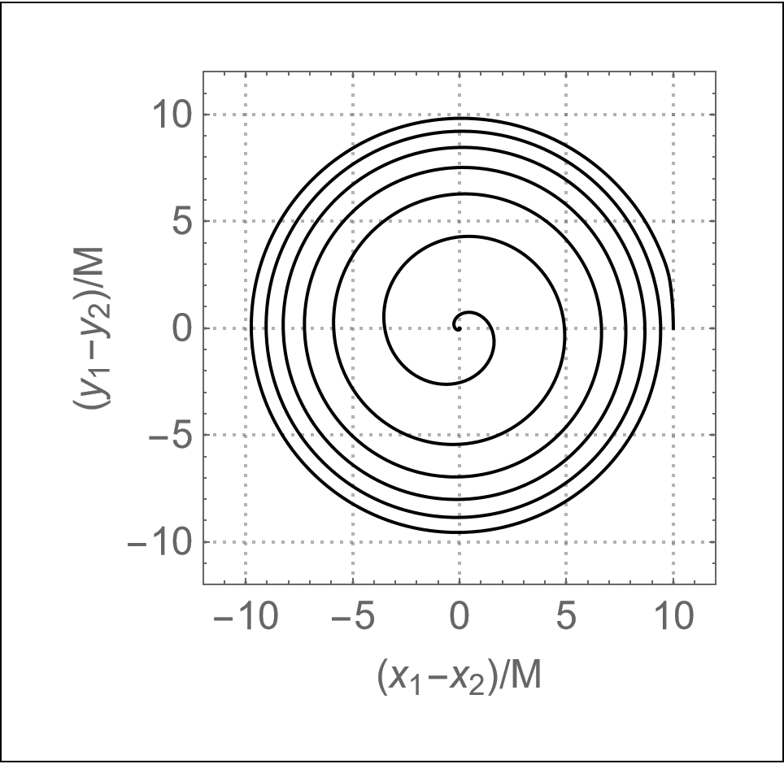

Slide 8
Result
 | Original paper | Reproduction
First common horizon | 232.5M, 105.5M | 262.506M, 108.139M
Final horizon mass | 0.933M, 0.978M | ?
Final spin | 0.89, 0.44 | ?
Final angular momentum | 0.77M^2, 0.42M^2 | ?

Slide 9
Initial data
initial-ADM-energy = 1.000090162964562657
initial-ADM-angular-momentumx = 0
initial-ADM-angular-momentumy = 0
initial-ADM-angular-momentumz = 1.177762899999999835
initial-separation = 6.118999999999999773
initial-data-type = Bowen-York
initial-data-bibtex-keys = Bowen:1980yu Brandt:1997tf Ansorg:2004ds
initial-bh-position1x = 3.059499999999999886
initial-bh-position1y = 0
initial-bh-position1z = 0
initial-bh-position2x = -3.059499999999999886
initial-bh-position2y = 0
initial-bh-position2z = 0
initial-bh-momentum1x = 0
initial-bh-momentum1y = 0.1290999999999999925
initial-bh-momentum1z = 0
initial-bh-momentum2x = -0
initial-bh-momentum2y = -0.1290999999999999925
initial-bh-momentum2z = 0
initial-bh-spin1x = 0
initial-bh-spin1y = 0
initial-bh-spin1z = 0.193899999999999989
initial-bh-spin2x = 0
initial-bh-spin2y = 0
initial-bh-spin2z = 0.193899999999999989
initial-bh-puncture-adm-mass1 = 0.5080812276120039161
initial-bh-puncture-adm-mass2 = 0.5080812276120040272
initial-bh-puncture-bare-mass1 = 0.334399999999999975
initial-bh-puncture-bare-mass2 = 0.334399999999999975
 | + +0.757 | - -0.757
 | 3.0595 | 3.465
 | 0.1291 | 0.1382
 | +0.1939 | -0.1924
 | 0.3344 | 0.3344

Slide 10
Setup
 | Original paper | Reproduction
Formalism | BSSN(chi-method*) | BSSN(W-method)
Lapse | Modified 1+log | 1+log
Shift | Modified Gamma-driver | Gamma-driver
Coordinate Type | Multiple transition fisheye(FMR)* | Multipatch(AMR)
Initial data solver | BAM_Elliptic* | TwoPunctures
Symmetry | Rotating 180° | Reflection on z-axis
* Unavailable ET now.

Slide 11
Todo
Must: add output files(Hamiltonian, Momentum constraint, etc.)
Resolve the anomalous orbit shape
Convergence test
Change Lapse & Shift condition
Z4-formulation?
Comparison with post-Newtonian result

